Slide 1

Operating Systems
Lecture 4

Slide 2
Agenda for Today
Review of previous lecture
Operating system structures
Operating system design and implementation
UNIX/Linux directory structure
Browsing UNIX/Linux directory structure
Useful UNIX/Linux commands
Recap of the lecture

Slide 3

UNIX System Structure

Slide 4
Layered Approach
The OS is broken up into a number of layers
Bottom layer is hardware and the topmost layer ( layer N) is the user interface
A typical layer consists of data structures and a set of routines to service the layer above it
THE operating system by Dijkstra
IBM’s OS/2

Slide 5

Layered Approach …

Slide 6
Layered Approach …
Modularity
Each layer uses functions and services of only lower layers
Simplifies debugging and system verification.
The major difficulty with layered approach is careful definition of layers, because a layer can only use the layers below it
Less efficient than other approaches

Slide 7
Microkernel
Structures the operating system by removing all non-essential components from the kernel and implementing them as system and user level programs
Smaller kernel
Main function is to provide a communication facility between client programs and the various services that are also running in the user space.

Slide 8
Microkernel …
Easier to extend the OS—new services are added to user space and consequently do not require modification of the kernel and/or its recompilation
Easier to maintain operating system code (enhancement, debugging, etc.)
OS is easier to port from one hardware to another
More security and reliability
Mach, MacOS X Server, QNX, OS/2, and Windows NT

Slide 9

Windows NT Client-Server Structure

Slide 10
Virtual Machines
CPU scheduling and virtual memory techniques used to emulate hardware of the underlying machine, on which user can install an operating system that the virtual machine supports
On a time-sharing system with virtual machine support, users may be working on different operating systems
Pioneered by IBM VM operating system that ran CMS, a single-user interactive operating system

Slide 11
Virtual Machines …
Difficult to implement.
System development done without disrupting normal system operation.

Slide 12

Virtual Machines …
Non Virtual Machine Virtual Machine

Slide 13
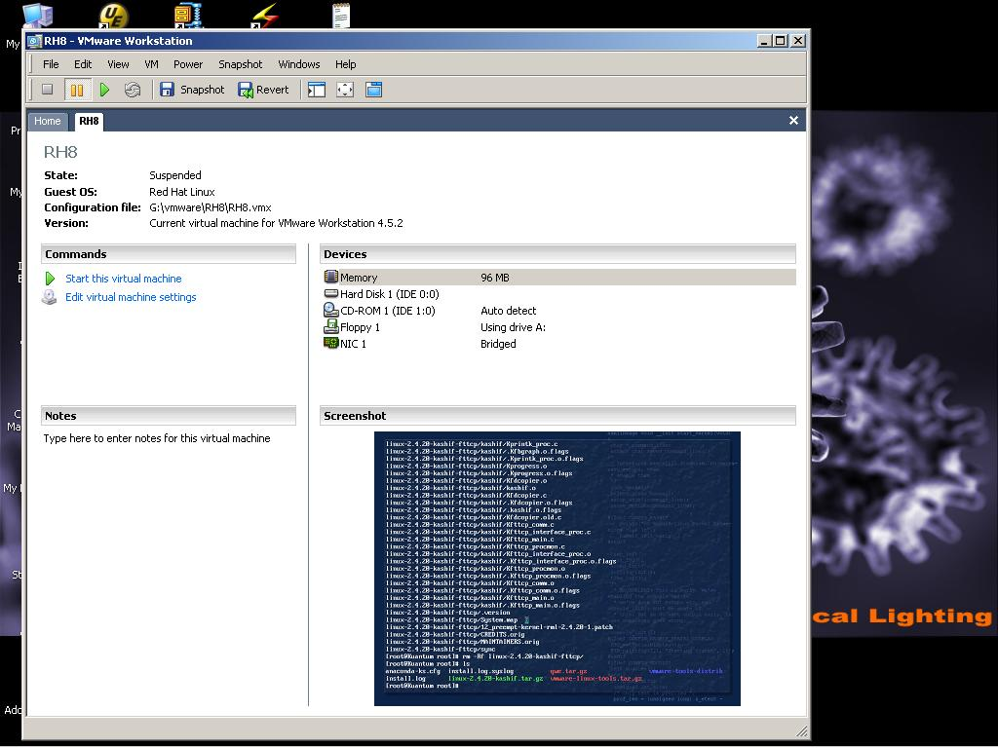
VMWare on Windows

Slide 14
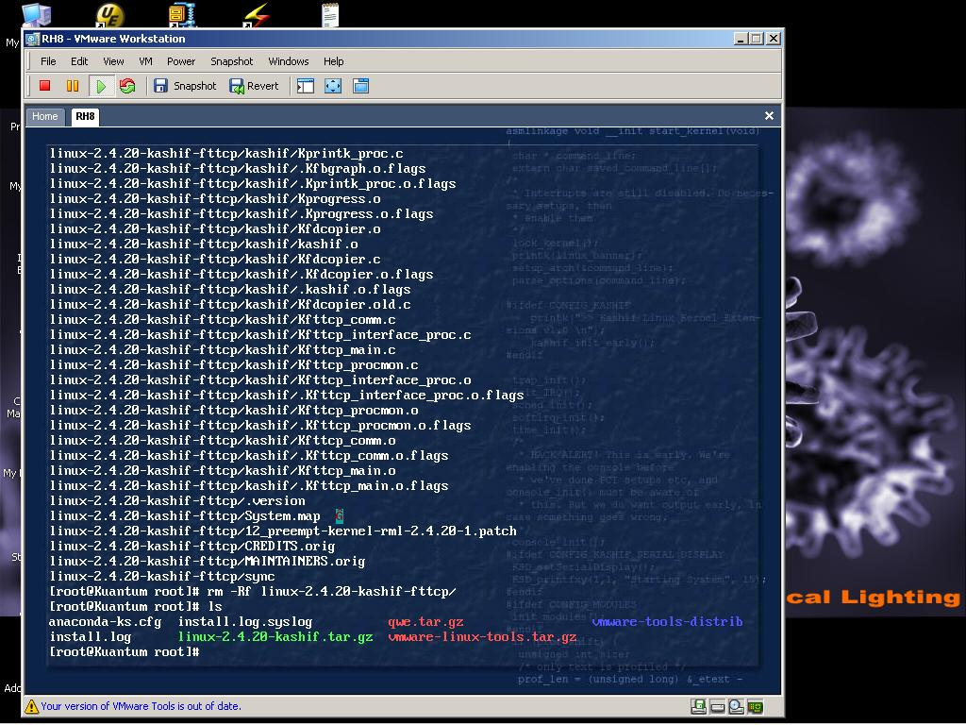
VMWare on Windows

Slide 15

Java Virtual Machine

Slide 16
System Design and Implementation
Design Goals
User: operating system should be convenient to use, easy to learn, reliable, safe, and fast.
System designer and administrator: operating system should be easy to design, implement, and maintain, as well as flexible, reliable, error-free, and efficient.

Slide 17
System Design and Implementation …
Mechanism: determine how to do something
Policy: determine what will be done
Separation of mechanism and policy is important for flexibility.

Slide 18
System Design and Implementation …
Implementation in:
Assembly language
Higher level languages:
  Easier to code
  Compact code
  Easier to port

Slide 19
Introduction to UNIX and Linux
Written by Dennis Ritchie and Ken Thomsom in at Bell Labs in 1969
Initially written in assembly language and a high-level language called B. Later converted from B to C language.
Linux written by Linus Torvalds (an undergraduate student at the Univ. of Helsinki, Finland) in 1991.
Most popular operating systems
Internet runs on UNIX and Linux

Slide 20
UNIX/Linux File System
UNIX has a hierarchical file system structure consisting of a root directory with other directories and files hanging under it
In a command-line user interface, typed commands are used to navigate the system
Directories and files are specified by filenames
  cs604/assignments/assign1.c
  /home/students/haroon/courses/cs604

Slide 21
Browsing Directory Structure
/ | The root directory is the directory that contains all other directories. When a directory structure is displayed as a tree, the root directory is at the top.
/bin | This directory holds binary executable files that are essential for correct operation of the system
/boot | This directory includes essential system boot files including the kernel image .

Slide 22
Browsing Directory Structure …
/dev | This directory contains the devices available to on the machine
/etc | Linux uses this directory to store system configuration files
/home | This is where every user on a Linux system has a personal directory
/lib | Shared libraries and kernel modules are stored in this directory

Slide 23
Browsing Directory Structure …
/root | The home directory for the superuser
/sbin | Utilities used for system administration (halt, ifconfig, fdisk, etc.) are stored in this directory
/tmp | Used for storing temporary files. Similar to C:\Windows\Temp.

Slide 24
Browsing Directory Structure …
/usr | Typically a shareable, read-only directory. Contains user applications and supporting files for those applications.
/var | This directory contains variable data files such as logs (/var/log), mail (/var/mail), and spools (/var/spool) among other things.

Slide 25
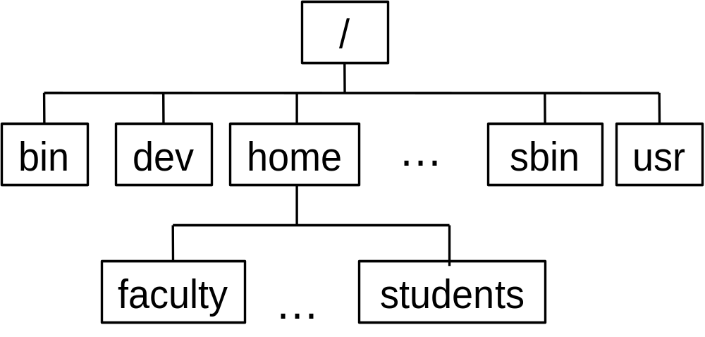
UNIX/Linux Directory Hierarchy

Slide 26
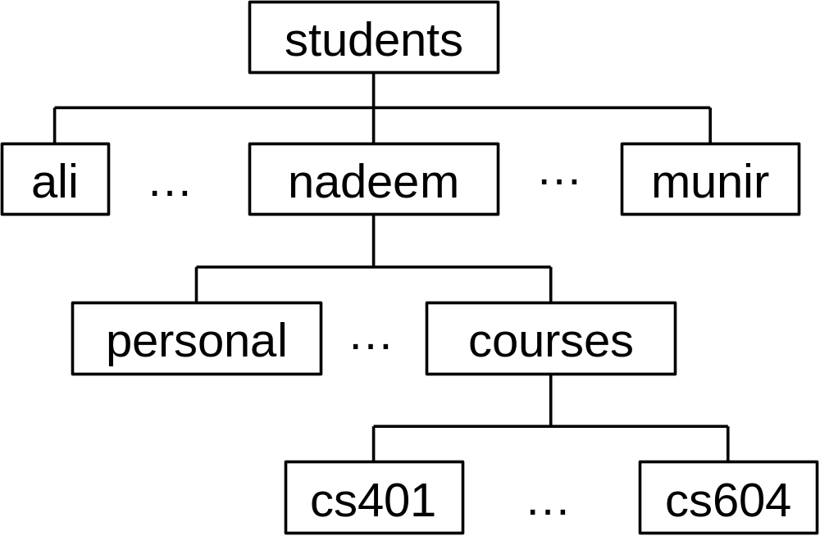
UNIX/Linux Directory Hierarchy

Slide 27
Recap
Review of previous lecture
Operating system structures
Operating system design and implementation
UNIX/Linux directory structure
Recap of the lecture

Slide 28
Operating Systems
Lecture 4

